Slide 1
人工智能引论
宋睿华
中国人民大学高瓴人工智能学院

Slide 2
人工智能与思维
盲目搜索
启发式搜索

Slide 3
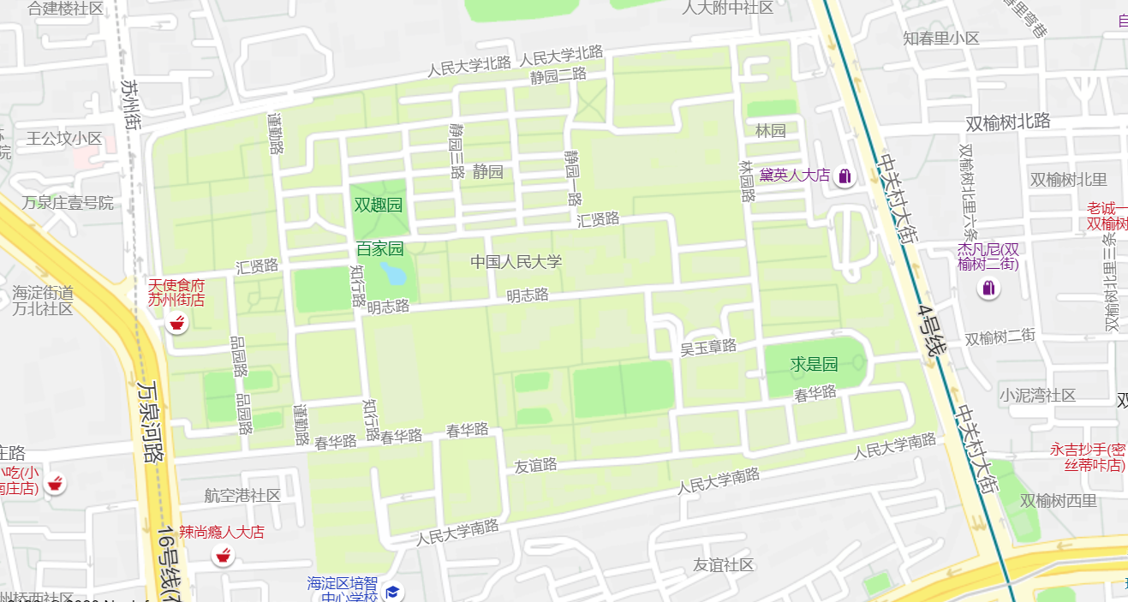
动作
状态
路径和代价（或耗散值）
目标检测

Slide 4
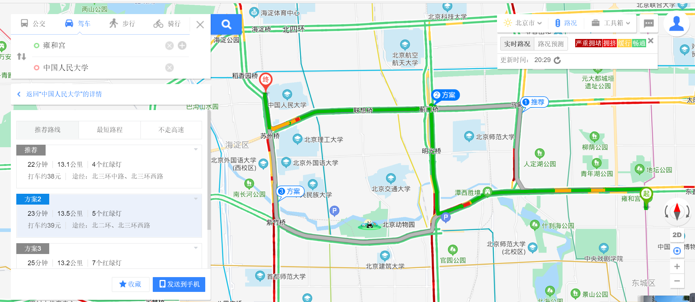

Slide 5
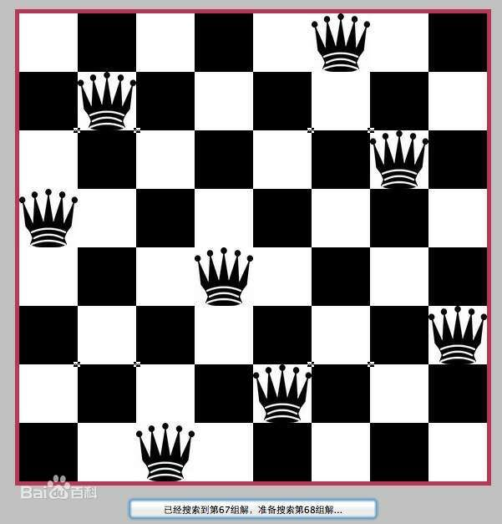

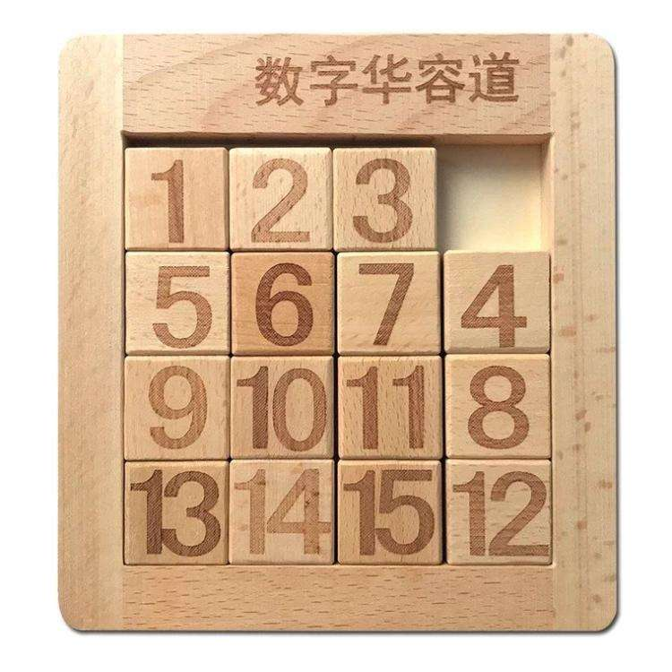
搜索问题举例
地图路径
传教士和野人问题
华容道问题
八皇后问题

Slide 6
搜索问题
S₀
问题全状态空间
搜索空间
解路径
S_{g}

Slide 7
盲目搜索与启发式搜索
盲目搜索：
深度优先搜索
宽度优先搜索
启发式搜索
A算法
A*算法

Slide 8
搜索
如何选择哪一个节点扩展？

Slide 9
1.1 深度优先搜索
优先扩展深度深的节点
例：皇后问题

Slide 10
( )

Slide 11
Q
( )
((1,1))

Slide 12
Q
( )
Q
((1,1))
((1,1) (2,3))

Slide 13
Q
( )
((1,1))
((1,1) (2,3))

Slide 14
Q
( )
Q
((1,1))
((1,1) (2,3))
((1,1) (2,4))

Slide 15
Q
( )
Q
Q
((1,1))
((1,1) (2,3))
((1,1) (2,4))
((1,1) (2,4) (3.2))

Slide 16
Q
( )
Q
((1,1))
((1,1) (2,3))
((1,1) (2,4))
((1,1) (2,4) (3.2))

Slide 17
Q
( )
((1,1))
((1,1) (2,3))
((1,1) (2,4))
((1,1) (2,4) (3.2))

Slide 18
( )
((1,1))
((1,1) (2,3))
((1,1) (2,4))
((1,1) (2,4) (3.2))

Slide 19
Q
( )
((1,1))
((1,2))
((1,1) (2,3))
((1,1) (2,4))
((1,1) (2,4) (3.2))

Slide 20
Q
( )
Q
((1,1))
((1,2))
((1,1) (2,3))
((1,1) (2,4))
((1,2) (2,4))
((1,1) (2,4) (3.2))

Slide 21
Q
( )
Q
Q
((1,1))
((1,2))
((1,1) (2,3))
((1,1) (2,4))
((1,2) (2,4))
((1,1) (2,4) (3.2))
((1,2) (2,4) (3,1))

Slide 22
Q
( )
Q
Q
((1,1))
((1,2))
Q
((1,1) (2,3))
((1,1) (2,4))
((1,2) (2,4))
((1,1) (2,4) (3.2))
((1,2) (2,4) (3,1))
((1,2) (2,4) (3,1) (4,3))

Slide 23
递归的思想
当前状态
目标状态g

Slide 24
深度优先搜索
Depth-First-Search (DATA)
DATA：当前状态。
返回值：从当前状态到目标状态的路径
（以规则表的形式表示）
或FAIL。

Slide 25
深度优先搜索
Depth-First-Search(DATA)
1, IF TERM(DATA) RETURN NIL;
2, IF DEADEND(DATA) RETURN FAIL;
3, RULES:=APPRULES(DATA);
4, LOOP: IF NULL(RULES) RETURN FAIL;
5, R:=FIRST(RULES);
6, RULES:=TAIL(RULES);
7, RDATA:=GEN(R, DATA);
8, PATH:= Depth-First-Search(RDATA);
9, IF PATH=FAIL GO LOOP;
10, RETURN CONS(R, PATH);

Slide 26
存在问题及解决办法
问题：
深度问题
当前状态
死循环问题
解决办法：
对搜索深度加以限制
记录从初始状态到当前状态的路径

Slide 27
深度优先搜索1
Depth-First-Search 1(DATALIST)
DATALIST：从初始到当前的状态表（逆向）
返回值：从当前状态到目标状态的路径
（以规则表的形式表示）
或FAIL。

Slide 28
深度优先搜索1
Depth-First-Search1(DATALIST)
1, DATA:=FIRST(DATALIST)
2, IF MEMBER(DATA, TAIL(DATALIST))
RETURN FAIL;
3, IF TERM(DATA) RETURN NIL;
4, IF DEADEND(DATA) RETURN FAIL;
5, IF LENGTH(DATALIST)>BOUND
RETURN FAIL;
6, RULES:=APPRULES(DATA);
7, LOOP: IF NULL(RULES) RETURN FAIL;
8, R:=FIRST(RULES);

Slide 29
深度优先搜索1
9, RULES:=TAIL(RULES);
10, RDATA:=GEN(R, DATA);
11, RDATALIST:=CONS(RDATA, DATALIST);
12, PATH:= Depth-First-Search 1(RDATALIST)
13, IF PATH=FAIL GO LOOP;
14, RETURN CONS(R, PATH);

Slide 30
深度优先搜索的性质
一般不能保证找到最优解
当深度限制不合理时，可能找不到解，可以将算法改为可变深度限制
最坏情况时，搜索空间等同于穷举
是一个通用的与问题无关的方法
节省内存，只存储从初始节点到当前节点的路径

Slide 31
1.2 宽度优先搜索
优先扩展深度浅的节点

Slide 32
宽度优先搜索
BREADTH-FIRST-SEARCH
1, G:=G0(G0=s), OPEN:=(s), CLOSED:=( );
2, LOOP: IF OPEN=( ) THEN EXIT (FAIL);
3, n:=FIRST(OPEN);
4, IF GOAL(n) THEN EXIT (SUCCESS);
5, REMOVE(n, OPEN), ADD(n, CLOSED);
6, EXPAND(n) →{m_{i}}, G:=ADD(m_{i}, G);
7, IF 目标在{mi}中 THEN EXIT(SUCCESS);
8, ADD(OPEN, m_{j}), 并标记m_{j}到n的指针;
9, GO LOOP;

Slide 33
1
2 3
1 8 4
7 6 5
2
3
4
2 8 3
1 4
7 6 5
2 3
1 8 4
7 6 5
2 3
1 8 4
7 6 5
5
8
6
7
2 8 3
1 6 4
7 5
2 8 3
1 4
7 6 5
2 8 3
1 4
7 6 5
1 2 3
8 4
7 6 5
2 3 4
1 8
7 6 5
2 8 3
1 6 4
7 5
2 8 3
1 6 4
7 5
8 3
2 1 4
7 6 5
2 8 3
7 1 4
6 5
2 8
1 4 3
7 6 5
2 8 3
1 4 5
7 6
1 2 3
7 8 4
6 5
1 2 3
8 4
7 6 5
目标

Slide 34
宽度优先搜索的性质
当问题有解时，一定能找到解
当问题为单位耗散值，且问题有解时，一定能找到最优解
方法与问题无关，具有通用性
效率较低
存储量比较大

Slide 35
1.3 启发式图搜索
优先扩展“最佳”节点
利用知识来引导搜索，达到减少搜索范围，提高搜索效率的目的。
启发信息的强度
强：降低搜索工作量，但可能导致找不到最优解
弱：一般导致工作量加大，极限情况下变为盲目搜索，但可能可以找到最优解

Slide 36
希望：
引入启发知识，在保证找到最佳解的情况下，尽可能减少搜索范围，提高搜索效率。

Slide 37
基本思想
定义一个评价函数f，对当前的搜索状态进行评估，找出一个最有希望的节点来扩展。

Slide 38
1，启发式搜索算法A（A算法）
评价函数的格式：
f(n) = g(n) + h(n)
f(n)：评价函数
h(n)：启发函数

Slide 39
符号的意义
g*(n)：从s到n的最短路径的代价
h*(n)：从n到g的最短路径的代价
f*(n)=g*(n)+h*(n)：从s经过n到g的最短路径的代价
g(n)、h(n)、f(n)分别是g*(n)、h*(n)、f*(n)的估计值
用f(n)对待扩展节点进行评价

Slide 40
修改指针举例
s
1
2
6
3
4
5

Slide 41
修改指针举例（续1）
s
1
2
6
3
4
5

Slide 42
修改指针举例（续2）
s
1
2
6
3
4
5

Slide 43
修改指针举例（续3）
s
1
2
6
3
4
5

Slide 44
Closed表
Open表
Notes:
A算法的思想，从open中选择一个节点

Slide 45
n
a
…...
…...
…...
b
m_{k}
m_{j}
m_{l}
…...
…...

Slide 46
A算法
1, OPEN:=(s), f(s):=g(s)+h(s);
2, LOOP: IF OPEN=( ) THEN EXIT(FAIL);
3, n:=FIRST(OPEN);
4, IF GOAL(n) THEN EXIT(SUCCESS);
5, REMOVE(n, OPEN), ADD(n, CLOSED);
6, EXPAND(n) →{m_{i}},
计算f(n, m_{i}):=g(n, m_{i})+h(m_{i});

Slide 47
A算法（续）
ADD(m_{j}, OPEN), 标记m_{j}到n的指针；
IF f(n, m_{k})<f(m_{k}) THEN f(m_{k}):=f(n, m_{k}),
标记m_{k}到n的指针；
IF f(n, m_{l})<f(m_{l},) THEN f(m_{l}):=f(n, m_{l}),
标记m_{l}到n的指针,
ADD(m_{l}, OPEN);
7, OPEN中的节点按f值从小到大排序；
8, GO LOOP；
Notes:
2018.9.29

Slide 48
一个A算法的例子：八数码问题
2 8 3
1 6 4
7 5
1 2 3
8 4
7 6 5
定义评价函数：
f(n) = g(n) + h(n)
g(n)为从初始节点到当前节点的耗散值
h(n)为当前节点“不在位”的将牌数

Slide 49
h计算举例
1 2 3
2 8 3
1 6 4
7 5
8
4
5
7 6
h(n) =4

Slide 50
s(4)
2 8 3
1 6 4
7 5
1
2 8 3
1 6 4
7 5
2 8 3
1 4
7 6 5
2
2 8 3
1 6 4
7 5
A(6)
B(4)
C(6)
3
4
2 8 3
1 4
7 6 5
2 3
1 8 4
7 6 5
2 8 3
1 4
7 6 5
D(5)
E(5)
F(6)
5
8 3
2 1 4
7 6 5
2 8 3
7 1 4
6 5
2 3
1 8 4
7 6 5
2 3
1 8 4
7 6 5
I(5)
J(7)
G(6)
H(7)
6
1 2 3
8 4
7 6 5
K(5)
1 2 3
8 4
7 6 5
1 2 3
7 8 4
6 5
M(7)
L(5)
目标

Slide 51
2，最佳图搜索算法A*（A*算法）
在A算法中，如果满足条件：
h(n)≤h*(n)
则A算法称为A*算法。

Slide 52
A*条件举例
8数码问题
h₁(n) = “不在位”的将牌数
h₂(n) = 将牌“不在位”的距离和
1 2 3
将牌1：1
将牌2：1
将牌6：1
将牌8：2
2 8 3
1 6 4
7 5
8
4
5
7 6

Slide 53
定义h函数的一般原则
放宽限制条件，在宽条件下，给出估计函数。

Slide 54
A*算法的两个主要结论
定理 (可采纳性定理)：
若存在从初始节点s到目标节点t有路径，则A*必能找到最佳解结束。

Slide 55
定理：设对同一个问题定义了两个A*算法A₁和A₂，若A₂比A₁有较多的启发信息，即对所有非目标节点有h₂(n) > h₁(n)，则在具有一条从s到t的路径的隐含图上，搜索结束时，由A₂所扩展的每一个节点，也必定由A₁所扩展，即A₁扩展的节点数至少和A₂一样多。
简写：如果h₂(n) > h₁(n) (目标节点除外)，则A₁扩展的节点数≥A₂扩展的节点数

Slide 56
注意：
上述定理，评价指标是“扩展的节点数”，也就是说，同一个节点无论被扩展多少次，都只计算一次。

Slide 57
对h的评价方法
平均分叉数
设共扩展了d层节点，共搜索了N个节点，则:
其中，b*称为平均分叉数。
b*越小，说明h效果越好。
实验表明，b*是一个比较稳定的常数，同一问题基本不随问题规模变化。

Slide 58
对h的评价举例
例：8数码问题，随机产生若干初始状态。
使用h₁：
d=14, N=539, b*=1.44;
d=20, N=7276， b*=1.47；
使用h₂：
d=14, N=113, b*=1.23;
d=20, N=676, b*=1.27

Slide 59
参考书目
吴飞，人工智能导论：模型与算法，高等教育出版社
马少平，朱小燕，人工智能，清华大学出版社
李航，智能与计算，中国计算机学会通讯，2019年第一期
尼克，人工智能简史，人民邮电出版社
Bergen B., Louder Than Words: The New Science of How the Mind Makes Meaning, Basic Books, 2012
Stuart J.Russell, Peter Norvig. Artificial Intelligence: a Modern Approach, Third Edition. Pearson Education Limited. 2016.
Richard S. Sutton and Andrew G. Barto. Reinforcement Learning: An Introduction. Second Edition. MIT Press, 2018

Slide 60
作业二：
请从下面的初始状态出发，定义至少两种h(n)，使用A*算法求解八数码问题，画出类似于课件50页的搜索过程，通过k.ruc.edu.cn提交，截止日期是本周日9月26日。
8 1 3
2 4
7 6 5

Slide 61
谢谢！

Slide 62




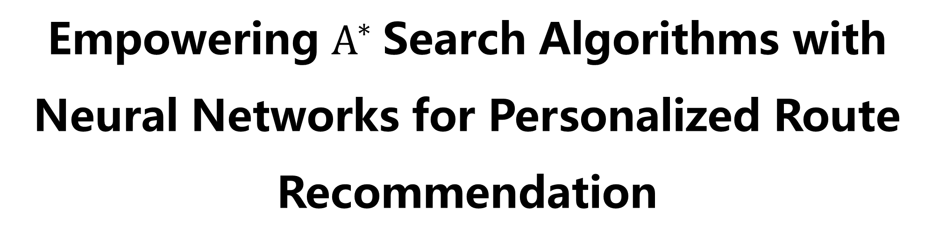

Empowering $A^{∗}$Search Algorithms with Neural Networks for Personalized Route Recommendation
Jingyuan Wang, Ning Wu, ${\text{Wayne} \text{Xin} \text{Zhao}}^{∗}$, Fanzhang Peng, Xin Lin
School of Computer Science and Engineering, Beihang University ${\text{School} \text{of} \text{Information}\text{, }\text{Renmin} \text{University} \text{of} \text{China}}^{∗}$
Notes:
Hello, everyone. Welcome to this oral presentation. I'm Yang Zhang from Beihang University. Actually you can see that I'm not the author of this paper. It's a great pity that the authors are all absent because of visa issue. So I'm here on behalf of my advisor to present this work. Now, let's get started. The title is Empowering A-Star search algorithms with neural networks for personalized route recommendation.

Slide 63
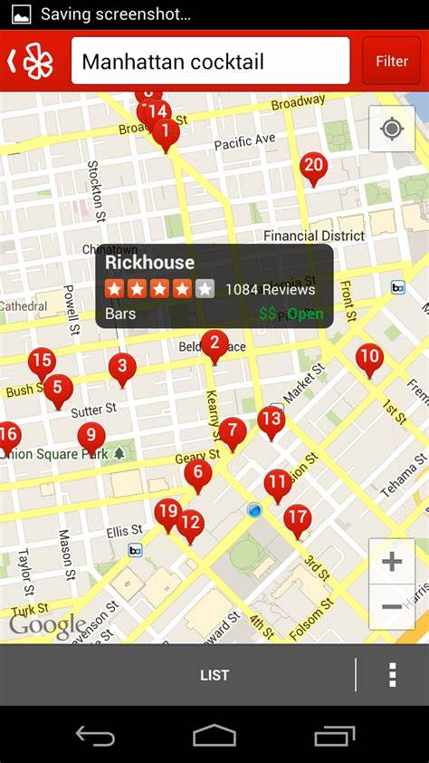
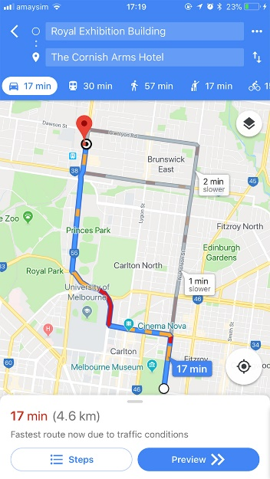
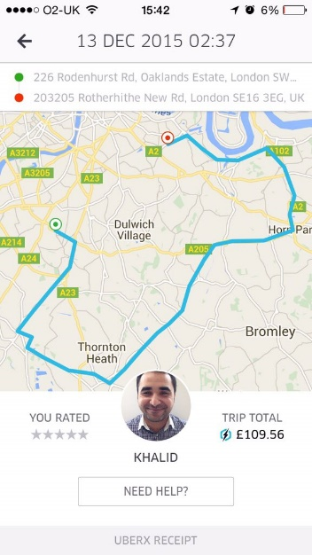



Background: Personalized Route Recommendation
Personalized Route Recommendation System has became one of the most core functions in many online applications, e.g., online map.
Personalized Route Recommendation aims to generate user-specific route suggestions on instant queries about the path planning from a source to a destination.
Notes:
Personalized route recommendation is an important problem, and has became one of the most core functions in many online applications.(翻页)
Given time, source and destination, it aims to offer user-specific route suggestions

Slide 64
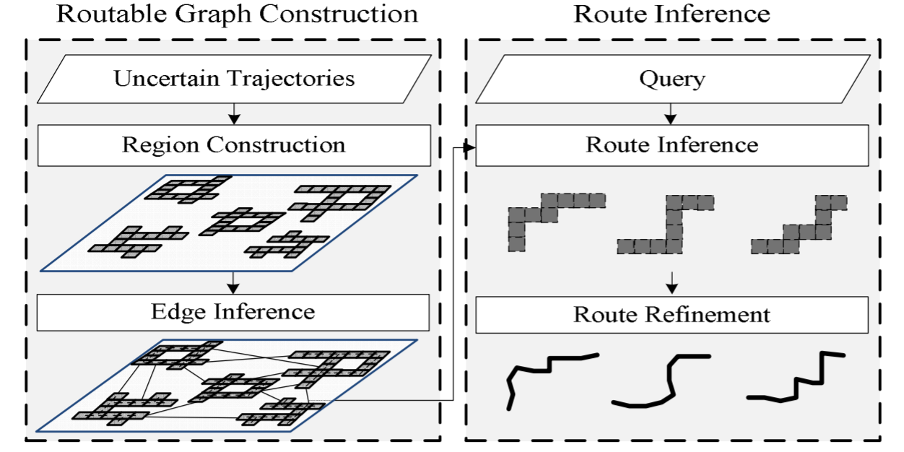
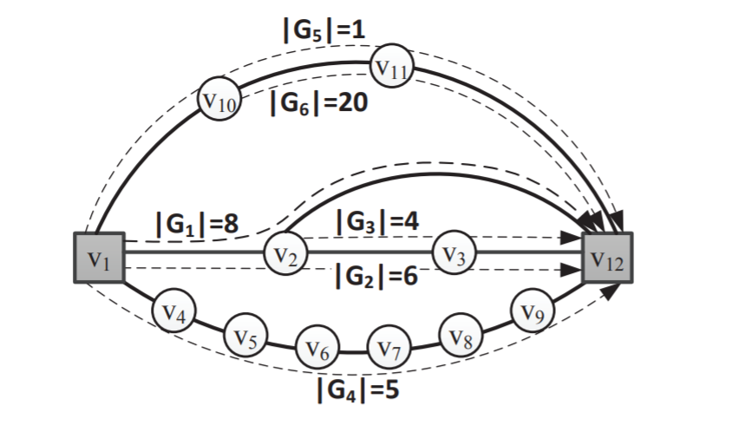
Background: Recommendation Methods
Heuristic Search: a basic recommendation method
Design cost function manually, and search an optimal path according to it.
Difficult to utilize various kinds of context information in the search process.
[Wei, 2012, KDD]
[Luo, 2013, SIGMOD]
Search-based Method
Notes:
Over past years, heuristic search has been a basic solution to route recommendation. Such algorithms search an optimal path according to mannually designed cost functions.
However, it’s difficult for such methods to utilize complex context information in the search process.

Slide 65
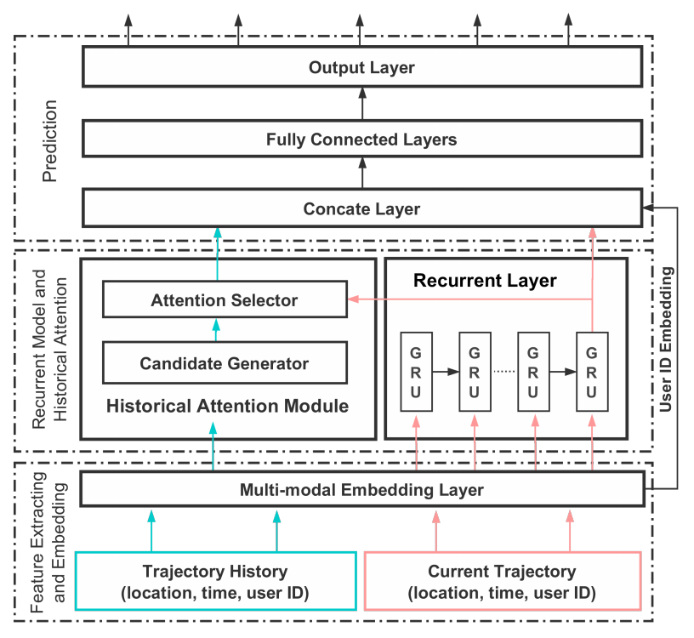
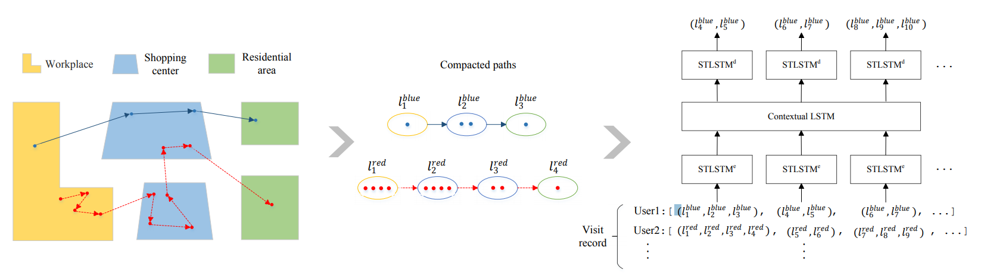
Background: Recommendation Methods
Neural Network: a rising recommendation method
Focus on one-step or short-term location prediction.
Sequential neural models have been widely used for modeling sequential trajectory data.
[Feng, 2018, WWW]
[Kong, 2018, IJCAI]
Neural Network Based Method
Neural network is a promising way to capture complex pattern in auxiliary data.
Notes:
Recently, neural network has been a rising method in the route recommendation filed. Many papers utilize recurrent neural networks to predict one-step or short-term locations.(翻页)
From these work, we can see that neural network is a promising way to capture complex patterns.

Slide 66
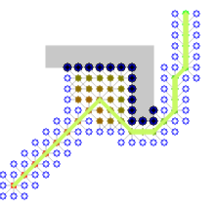

Background: Motivation
Our idea
Heuristic search is able to generate high-quality approximate solutions using proper cost functions.
Deep learning methods are effective to capture the complex data characteristics using learnable neural networks.
Our idea is to learn cost functions of the A* search algorithm by neural networks.
A* search algorithm
Deep Learning
+
=
OUR IDEA
Notes:
Since heuristic search is a great framework for route recommendation and deep learning methods are effective to capture complex data characteristics, we propose to learn the cost functions of A* search algorithm by neural networks.

Slide 67



Background: Key Research Problems
Define a suitable form for the cost in the PRR task.
Minimize negative logarithmic probability.
Design effective models for implementing cost functions with
different purposes.
Observable cost and estimated cost.
Utilize rich context and constraint information for improving the task performance.
Context
Constraint
User History
Time
Road Network
Neuralized A-Star based personalized Route recommendation
Notes:
To solve this problem with the combination of A* search and neural networks, there are three key points. Firstly, we need to define a suitable form of the cost. What's more, effective models should be designed to learn the cost functions of A* algorithm. Last but not least, it will be of great help if we can fully utilize rich context and contraint information. Focusing on the three problems above, we propose the Neuralized A-Star based personalized Route recommendation Model.

Slide 68
Background: Problem Definition
Node：location
Edge: road segment
Road Network
Route
Location Sequence
8:00
10:00
Trajectory
9:00
Location Sequence and Arrived Time
8:00
Query
Departure Time, Source Location and Destination Location
8:00
Personalized Route Recommendation
Given departure time, source location and destination location, infer the most possible route for user.
Notes:
We shall first give the formula definition of personalized route recommendation. A road network consists of node and edge, node is location and edge is road segment. A route is a location sequence and a trajectory is a route with arrived time of every location. A query consists of departure time, source location and destination location. Our goal is to infer the most possible route given a user's query.

Slide 69
Background: Review of A* Algorithm
A* Search Algorithm
f(a) = g(a) + h(a)
Find the shortest path on graph
Candidate:
a
Flexible to adapt different task
Effective and efficient
Current:
Cost Function
b
Choose location with least cost
Find the path with least cost
c
Consist of two part: observable cost g and estimated cost h
f(b) < f(a) < f(c)
Notes:
Before introducing our model, I want to do a review of the A-Star algorithm. Originally, A-Star algorithm is designed to find the shortest path on graph, and it can be flexibly adapted to different tasks. Compared with other search algorithms such as Dijkstra and deep first search, it’s effective and efficient.
The core of A-Star Algorithm is the cost functions. The search procedure in A-Star algorithm is to find the path with least cost. The cost consists of two parts, in this paper, we call them observable cost g and estimated cost h. In this picture, you can see that the A-Star algorithm will choose the location with least cost at every expansion until it arrives the destination.

Slide 70
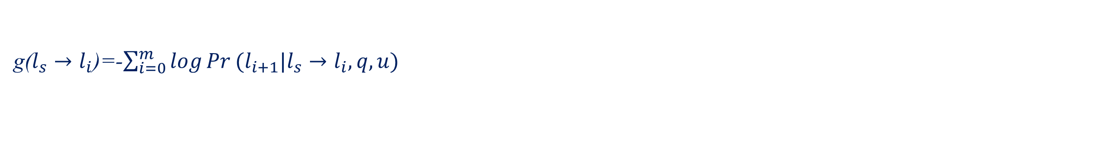
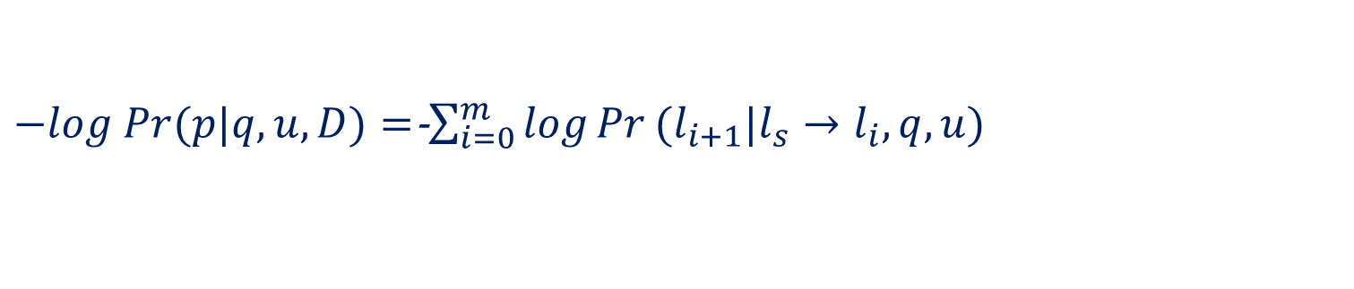
Background: A Simple A*-based Approach for PRR
Our Target
Minimize its negative log: $−log Pr(p|q,u,D)$
Given a possible path $p: l_{s}→l_{1}→l_{2}\text{…}→l_{m} →l_{d}$
It can be rewritten as:
$−log Pr(p|q,u,D)=$-$\sum_{i=0}^{m}{\log{Pr}(l_{i+1}|l_{s}→l_{i}, q,u)}$
Design Cost Function
g($l_{s}→l_{i}$)=-$\sum_{i=0}^{m}{\log{Pr}(l_{i+1}|l_{s}→l_{i}, q,u)}$
$Pr$ can be calculated by shallow model.
h($l_{i}→l_{d}$)= Euclid($l_{i},l_{d}$) or ?
h($l_{i}→l_{d}$) can be designed manually.
Notes:
So, a A-star based approach can be summarized as follow, our target is to minimize the negative log likelihood. Given a path consisting of m locations, we can factorize the path to compute its cost according to the chain rule .
We can compute the observable cost of a candidate location i as this foluma, and Pr can be calculated by shallow models.
Actually, the computation of the estimated cost is much more difficult, since the optimal sub-route for location i to location d is unknown. People usually design it manually under certain rules.

Slide 71
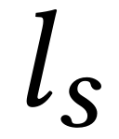
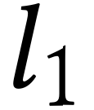
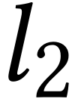
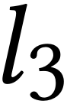
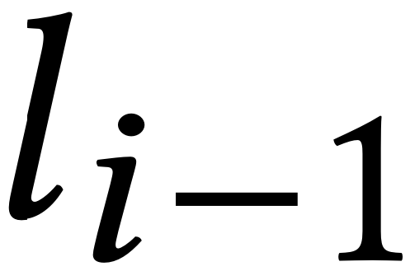

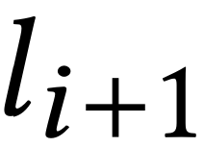
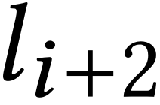
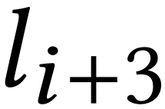
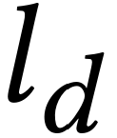
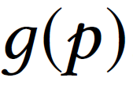
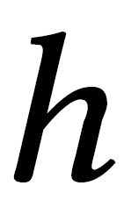
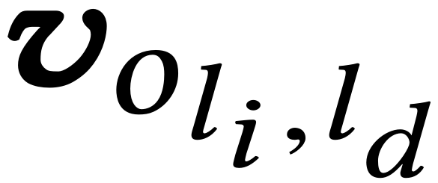
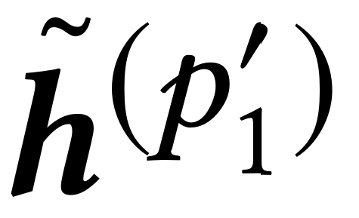
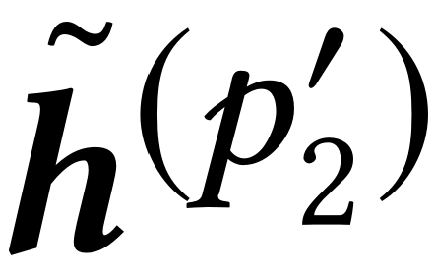
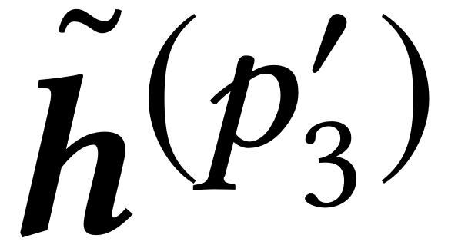
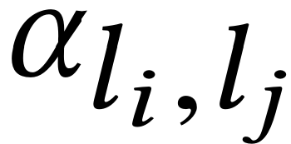

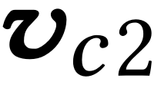
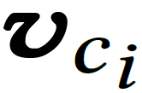
NASR: Overall
Observed Sub-Trajectory
Next Location
Unobserved Sub-Trajectory
Source
Destination
…………
……
Inter-trajectory ATT
Moving
State
MLP
Intra-trajectory ATT
n_{li}
Distance from l_{i} to l_{d}
n_{ld}
GRU
GRU
GRU
GRU
……
……
User History Trajectories
Current Sub-Trajectory
Road Network
Notes:
This is the overall architecture of our model - NASR. On the left, it's the observable cost network, and it consists of intra-trajectory attention and inter-trajectory attention. On the right, it's the estimated cost network, and it consists of a context-aware graph attention network and a MLP.

Slide 72
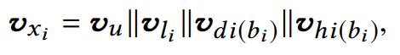
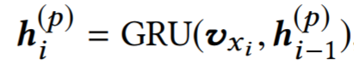
NASR: Observed Cost
Embedding Rich Context Information
Inter-trajectory ATT
day
hour
user
location
temporal
Intra-trajectory ATT
Extracting Sequential Feature by GRU
GRU
GRU
GRU
GRU
We employ the widely used GRU network to encode it into a vector.
……
……
User History Trajectories
Current Sub-Trajectory
Notes:
Now let's dive into the observable cost network. First, we consider to combine several information together. The user, location and temporal representation are concatenated into a new vector. Then, GRU is employed to extract sequential dependence.

Slide 73
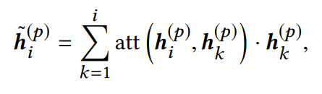
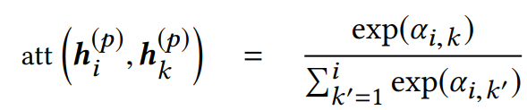
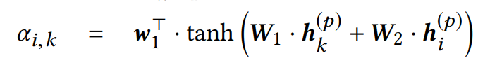
NASR: Observed Cost
Intra-Trajectory Attention
Inter-trajectory ATT
Intra-trajectory ATT
GRU
GRU
GRU
GRU
……
……
With intra-trajectory attention, we can discover more important characteristics by considering the entire trajectory.
User History Trajectories
Current Sub-Trajectory
Notes:
Based on sequential hidden states extracted by GRU, we propose intra-trajectory attention to capture important characteristics of the entire trajectory.

Slide 74
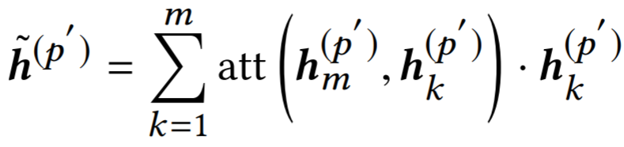
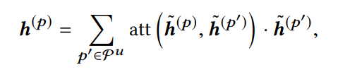


NASR: Observed Cost
User History Trajectories
For every historical trajectory $p^{′}$ of a user, we have:
Inter-trajectory ATT
Inter-Trajectory Attention
Intra-trajectory ATT
Given the current trajectory p, we attend it to each of the other historical trajectories as
GRU
GRU
GRU
GRU
……
……
User History Trajectories
where $p^{u}$ denotes the set of historical trajectories generated by $u$.
Current Sub-Trajectory
Notes:
Furthermore, the historical trajectories of the same user is also important to model user-preference, hence, we introduce inter-trajectory attention mechanism to take the user's historical trajectories into account.

Slide 75
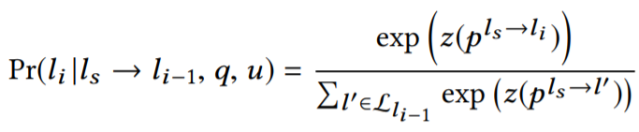
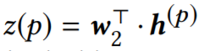
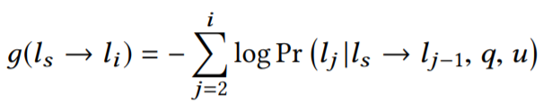
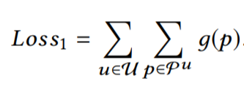
NASR: Observed Cost
Road Network Constraints
We are able to compute the probability of the next location using a softmax function with road network constraint.
Inter-trajectory ATT
Intra-trajectory ATT
GRU
GRU
GRU
GRU
Observable Cost Computation
……
……
Loss
User History Trajectories
Current Sub-Trajectory
Notes:
Once we have learned the finnal representaion of the trajectory, we are able to compute the probability of the next location using a softmax function with road network constraint. (翻页)
Finanly the observable cost g can be calculated as this formula we have mentioned before.
and the observable cost network can be optimized by this loss function(翻页)

Slide 76
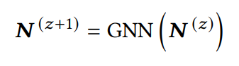
NASR: Estimated Cost
Moving
State
Graph Neural Network
MLP
Learning effective structural representations for summarizing graph nodes. The update of graph neural networks can be given as
n_{li}
Distance from l_{i} to l_{d}
n_{ld}
Here, we adopt the recently proposed Graph ATTention network (GAT) for a good balance between capacity and efficiency. In GAT, the key part is to compute the attention importance of a node on another.
Road Network
Notes:
To model the estimated cost h , we introduce graph neural network in our model. We choose graph attention network to model road network since it’s effective and efficient in previous studies. In graph attention network, the key point is to compute the attention weights.

Slide 77
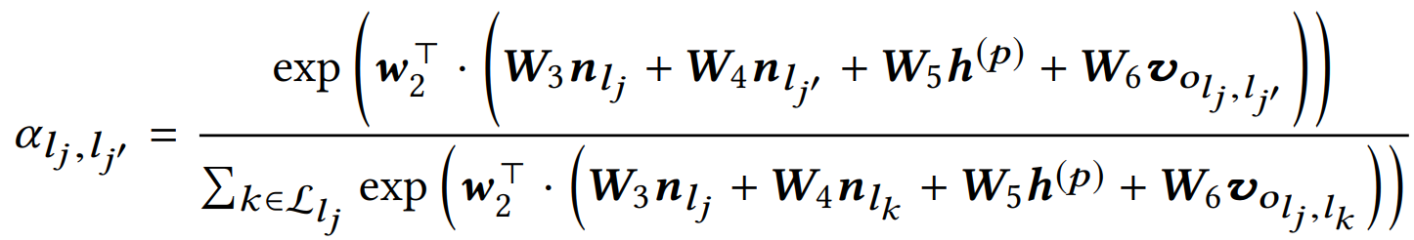
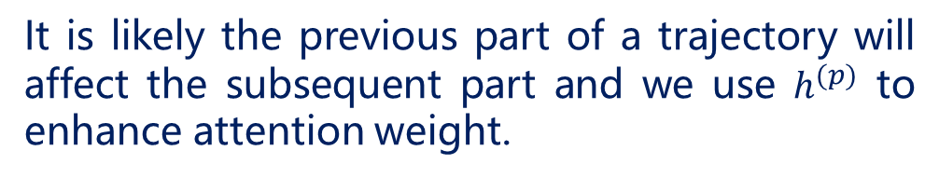
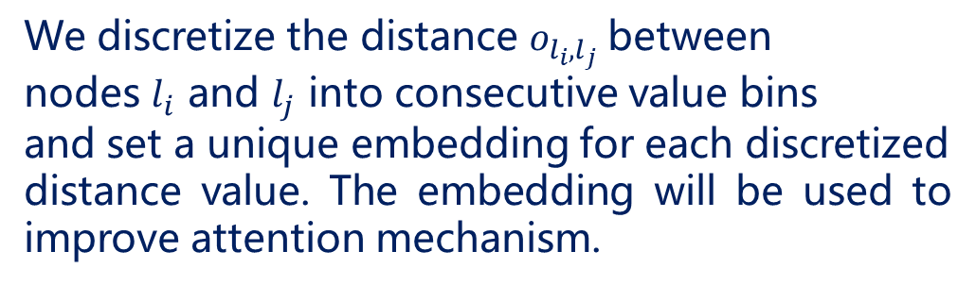
NASR: Estimated Cost
Context-aware Graph Attention
Moving
State
MLP
We discretize the distance $o_{l_{i},l_{j}}$between
nodes $l_{i}$ and $l_{j}$ into consecutive value bins
and set a unique embedding for each discretized
distance value. The embedding will be used to improve attention mechanism.
n_{li}
Distance from l_{i} to l_{d}
n_{ld}
It is likely the previous part of a trajectory will affect the subsequent part and we use $h^{(p)}$ to enhance attention weight.
Road Network
Notes:
Based on graph attention network, we propose context-aware graph attention mechanism. Besides node and edge, we alse take geographical distance and user preference into consideration. The distance between location i and j is discretized into token, and these tokens will be embedded into vector. Moving state h^p comes from observable cost network, which is the output of Inter-Trajectory Attention. The distance vector and moving state will be used to compute the attention weights, so as to improve the performance of graph attention network.

Slide 78
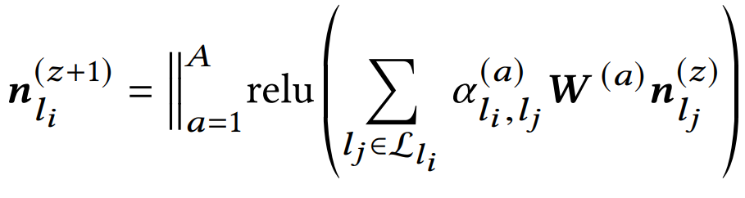
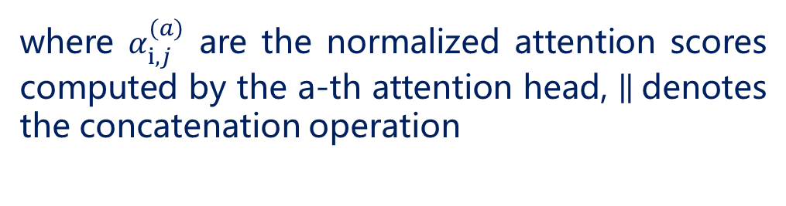
NASR: Estimated Cost
Multi-head Attention
Moving
State
MLP
Since our attention mechanism involves many kinds of information, we use the multi-head attention for stabilizing the learning process.
n_{li}
Distance from l_{i} to l_{d}
n_{ld}
where $α_{i,j}^{(a)}$ are the normalized attention scores computed by the a-th attention head, denotes the concatenation operation
Road Network
Notes:
Similar to the transformer, we also use multi-head attention mechanism to stabilizing the learning process

Slide 79


NASR: Estimated Cost
Predicting the Estimated Cost with A MLP Component
Moving
State
MLP
Fuse context vector, node representation
and distance information.
n_{li}
Distance from l_{i} to l_{d}
n_{ld}
The MLP component takes as input the moving state $h^{(p)}$, the node representations $n_{l_{i}}$ and $n_{l_{d}}$ for locations of $l_{i}$ and $l_{d}$, and the embedding $v_{o_{l_{i},l_{d}}}$ for their spatial distance.
Road Network
Notes:
After several iterations of graph attention network, we use a MLP to fuse context vector, node representation and distance information. The MLP finally output the estimated cost.

Slide 80





NASR: Estimated Cost
Estimated Cost Network Training
When a location $l_{i}$ is selected, an immediate cost $c_{i}$ will be yielded according to:
Moving
State
MLP
n_{li}
Distance from l_{i} to l_{d}
n_{ld}
Estimated cost:
Temporal difference learning:
Road Network
Loss:
Notes:
Next, I will talk about the training method of the estimated cost network. （翻页）
When a location i is selected, an immediate cost c_i will be yielded according to this formula. （翻页）
改公式
So, the real estimated cost between location i and d can be modeled as this formula. （翻页）
We use temporal difference learning to optimize this network, since the computation of estimated cost is a multi-step decision process and is difficult to be optimized directly.

Slide 81
NASR: Model Training
Load data
Pretrain
Pretrain observable cost network
Pre-train the observable cost network component.
Yes
Model
converged
No
Joint Learning
Perform gradient descent on observable cost network
End
Train the two components jointly using alternative optimization
Perform TD learning on estimated cost network
Notes:
This is the training procedure of our model. （翻页）
We first pre-train the GRU based observable cost network. （翻页）
Then, we train the two components jointly using alternative optimization by iterating the trajectories in training set.

Slide 82



Experiments: Data Description
Remove stay points and noisy points
Processed Trajectories
Map Matching
Raw Trajectories
Final Datasets
Road network from OpenStreetMap
Notes:
Next, we are going to talk about the experiments. We collected three datasets, named Beijing taxi, porto taxi and Beijing bicycle. These data are processed by removing stay points and noisy points. Meanwhile, we collected road network of Beijing and Porto from OpenStreetMap. Processed trajectories are matched to road network by an open-source map-matching algorithm. Finally, we got three processed datasets. Statistics of the three datasets can be seen in table 1.

Slide 83



Experiments: Metric and Baselines
Benchmarks
Evaluation Metrics
RICK [KDD 2012]: Search-based method
MPR [KDD 2011]: Search-based method
CTRR [IJDE 2018]: Collaborative filtering
STRNN [AAAI 2016]: RNN with spatial-temporal
contexts
DeepMove [WWW 2018]: RNN with attention
Notes:
On the left, it’s the evaluation metrics, precision, recall and F1. They can be used to evaluate the difference between the inferred route and the groudtruth.
On the right is our five benchmarks, RICK and MPR are search-based methods while STRNN and DeepMove are deep learning methods. CTRR is a collaborative filtering based method.

Slide 84

Experiments: Effectiveness
We discuss three types of query：
Short (10 to 20 locations),
Medium (20 to 30 locations),
Long (more than 30 locations).
Notes:
To evaluate different conditions, we consider short, medium and long query. Short query ranges from ten to twenty locations, medium query ranges from twenty to thirty locations, and long query is more than thirty locations.
Here is the precision and recall of our model on three datasets.

Slide 85

Experiments: Effectiveness
Our proposed model NASR performs best among all the methods. Because it combines both the benefits of heuristic search and neural networks.
Notes:
Here is the result of F1 score. From the two columns, you can see that our proposed model NASR performs best among all the methods. Because it combines both the benefits of heuristic search and neural networks.

Slide 86
Experiments: Effectiveness
Heuristic search methods perform very well, especially the RICK method. RICK fully characterizes the road network information and adopts the informed A ∗ algorithm.
Notes:
As for the heuristic search methods, i.e., RICK and MPR, they perform very well, especially the RICK. RICK fully utilize the road network information and adopts the informed A-star algorithm.

Slide 87
Experiments: Effectiveness
The matrix factorization based method CTRR does not perform better than RICK and MPR. A possible reason is that CTRR can not fully utilize the road network information.
Notes:
Next, the matrix factorization based method CTRR does not perform better than RICK and MPR. A possible reason is that CTRR can not fully utilize the road network information. Besides, it has limited capacities in learning complex trajectory features

Slide 88
Experiments: Effectiveness
Deep learning method DeepMove performs very well. Compared with STRNN, DeepMove considers more kinds of context information and designs more advanced sequential neural networks.
Notes:
Also, deep learning method DeepMove performs very well among all the baselines, while STRNN gives a worse performance. Compared with STRNN, DeepMove considers more kinds of context information and designs more advanced sequential neural networks.

Slide 89


Experiments: Detailed Analysis
NA : Without attention.
IA : Using only intra-trajectory attention.
BA : Using both intra- and inter-trajectory
attention.
${BA}_{¬s}$ : The model that does not provide the moving state to the h(·) function
NA < IA < BA and ${BA}_{¬s}$ < BA
Conclusion: Inter-trajectory attention and
Intra-trajectory attention are both effective.
Notes:
Here comes the ablation study, we consider three variants of the attention mechanism for implementing observable cost function: without attention (NA), using only intra-trajectory attention (IA) and using both intra- and inter-trajectory attention (BA).
Recall our GRU component is also able to learn a vectorized representation for the moving state of users. We further prepare a variant for verifying the effect of the learned moving state in the value network, namely the model that does not provide the moving state to the estimated cost function.
It shows that both intra- and inter-trajectory attention are important to improve the performance of the PRR task. Especially, the learned moving state from the GRU component is useful for the value network. When the moving state is incorporated, the performance has been greatly improved.

Slide 90
Experiments: Detailed Analysis
ED : Using Euclid distance.
SL : Using supervised learning.
SP : Using scalar product between the embeddings
of the candidate and destination locations.
MC : Using Monte Carlo method.
o-GAT : Using the original implementation of graph
attention networks.
n-TD: Using temporal difference
learning.
i-GAT: Using our improved GAT by incorporating
context information.
Notes:
On the left, we present four variants of the estimated cost function. We can see that the simplest spatial distance baseline ED gives the worst performance, which indicates simple heuristics may not work well in our task. Graph attention networks are more effective to capture structural features from a graph. When incorporating context information, our value network is able to outperform the variant using original implementation.
On the right, we present the performance of three training methods. We can see that the simplest supervised learning method performs worst. Since the prediction involves multi-step search process, it is not easy to directly fit the distance using traditional supervised learning methods. Compared with all the methods, we can see that the TD learning method is the most effective way for the estimated cost.

Slide 91



Experiments: Qualitative Analysis(1)
Visualization of the learned association scores using improved graph attention networks. The colored circles denote locations in the road network. A darker color indicates a larger importance degree w.r.t. current location $l_{i}$ and destination $l_{d}.$ “$freq "$ denotes the visit frequency by the user in historical trajectories.
Notes:
For a candidate location j , we compute its importance by a simple formula on the right, where n(·) is the location representations learned after training.
It can be seen that locations with larger importance have larger visit frequency, which means our graph attention mechanism is effective.

Slide 92

Experiments: Qualitative Analysis(2)
By comparing (a) (the original search space) and (b) (the reduced search space by NASR)，it can be seen that our model is able to effectively reduce the search space.
Notes:
By comparing the two figures, one is the original search space and the other one is the reduced search space by NASR，it can be seen that our model is able to effectively reduce the search space.

Slide 93

Experiments: Qualitative Analysis(3)
Visualization of the search procedure with the estimated costs by the NASR model. In (c), red points have been already explored and green points are candidate locations to extend in $A^{∗}$search algorithm.
Notes:
When zooming into a subsequence of this route, we further compare the estimated cost values for two candidate locations (which are the green points)
Although the location on the right has a longer distance than the left one, it is located on the main road that is much more likely to lead a better traffic condition. Our model is able to predict a lower cost for such location by effectively learning from road network constraint and historical data.

Slide 94
Conclusion
We first presented a simple A ∗ solution for solving the PRR task, and formally defined the suitable form of the cost.
We set up two components to learn the two cost respectively, i.e., the GRU component for g(·) and the value network for h(·).
Currently, we focus on the PRR task. We will also study whether our solution can be generalized to solve other complex search tasks.

Slide 95
Question?
Email to the authors:
jywang@buaa.edu.cn
wuning@buaa.edu.cn

Slide 96
3，A*算法的改进
问题的提出：
因A算法第6步对m_{l}类节点可能要重新放回到OPEN表中，因此可能会导致多次重复扩展同一个节点，导致搜索效率下降。

Slide 97
一个例子：
OPEN表
CLOSED表
s(10)
1
s(10)
s(10)
C(8)
A(7) B(8) C(9)
A(7) s(10)
3
6
B(8) C(9) G(14)
B(8) s(10)
1
1
B(5)
A(5) C(9) G(14)
A(5) B(8) s(10)
A(1)
C(9) G(12)
C(9) A(5) s(10)
8
B(7) G(12)
B(7) C(9) s(10)
A(4) G(12)
A(4) B(7) C(9) s(10)
G 目标
G(11)

Slide 98
出现多次扩展节点的原因
在前面的扩展中，并没有找到从初始节点到当前节点的最短路径，如节点A。
问题的突破口？
s(10)
1
C(8)
3
6
1
1
B(5)
A(1)
8
G 目标
Notes:
突破口：H值估计的要合理，即应该满足单调条件。考虑到h满足A*条件，所以父子节点的h值差，应该小于等于c才合理。

Slide 99
解决的途径
对h加以限制
能否对h增加适当的限制，使得第一次扩展一个节点时，就找到了从s到该节点的最短路径。
对算法加以改进
能否对算法加以改进，避免或减少节点的多次扩展。

Slide 100
改进的条件
可采纳性不变
不多扩展节点
不增加算法的复杂性

Slide 101
对h加以限制
定义：一个启发函数h，如果对所有节点n_{i}和n_{j}，其中n_{j}是n_{i}的子节点，满足
h(n_{i}) - h(n_{j}) ≤ c(n_{i}, n_{j})
h(t) = 0
或
h(n_{i}) ≤ c(n_{i}, n_{j}) + h(n_{j})
h(t) = 0
则称h是单调的。
n_{i}
c(n_{i},n_{j})
n_{j}
h(n_{i})
h(n_{j})

Slide 102
h单调的性质
定理：
若h(n)是单调的，则A*扩展了节点n之
后，就已经找到了到达节点n的最佳路径。
即：当A*选n扩展时，有g(n)=g*(n)。
思考题：h(n)单调与A*条件的关系，即当h(n)满足单调条件时，是否一定满足A*条件。

Slide 103
h单调的例子
8数码问题：
h为“不在位”的将牌数
1
h(n_{i}) - h(n_{j}) = 0 (n_{j}为n_{i}的后继节点)
-1
h(t) = 0
c(n_{i}, n_{j}) = 1
满足单调的条件。

Slide 104
对算法加以改进
一些结论：
OPEN表上任一具有f(n) < f*(s)的节点定会被A*扩展。
A*选作扩展的任一节点，定有f(n)≤f*(s)。
当h(n)恒等于0时，h为单调的。

Slide 105
改进的出发点
f*(s)
OPEN = ( … … … … )
f值小于f*(s)的节点
f值大于等于f*(s)的节点
f_{m}：到目前为止已扩展节点的最大f值，用f_{m}代替f*(s)

Slide 106
修正过程A
1, OPEN:=(s), f(s)=g(s)+h(s), f_{m}:=0;
2, LOOP: IF OPEN=( ) THEN EXIT(FAIL);
3, NEST:={n_{i}|f(n_{i})<f_{m},n_{i}∈OPEN}
IF NEST ≠ ( ) THEN n:=NEST中g最小的节点
ELSE n:=FIRST(OPEN),
f_{m}:=f(n);
4, …, 8: 同过程A。

Slide 107
4, IF GOAL(n) THEN EXIT(SUCCESS);
5, REMOVE(n, OPEN), ADD(n, CLOSED);
6, EXPAND(n) →{m_{i}},
计算f(n, m_{i}):=g(n, m_{i})+h(m_{i});
ADD(m_{j}, OPEN), 标记m_{j}到n的指针；
IF f(n, m_{k})<f(m_{k}) THEN f(m_{k}):=f(n, m_{k}),
标记m_{k}到n的指针；
IF f(n, m_{l})<f(m_{l},) THEN f(m_{l}):=f(n, m_{l}),
标记m_{l}到n的指针,
ADD(m_{l}, OPEN);
7, OPEN中的节点按f值从小到大排序；
8, GO LOOP；
Notes:
老师您好, 有关人工智能导论的PPT和您讲授内容我在复习的时候发现有些小瑕疵, 我想在这里斗胆指出一下:1. 11讲77页的示例中的 h 是非单调的, 事实上这是因为76的算法的目的是为了利用 h 单调的情况下的A*算法的性质去改造 h 单调的情况的. 对于单调的 h 的 A* 算法, 由于在 Close 表中每个拓展后节点记录的耗散值 g(x) 就是 g*(x), 所以没有必要对 Close 表的节点进行修改. 对于非单调的 h(x), 通过从 Open 表中划分出所有比 fm 小的 Open 表的节点, 我们证明了这些节点一定会被拓展. 将这些节点存储于 Nest 表中,且不考虑节点的 h(x) 而只考虑 g(x), 从而使得在 Nest 表内的所有节点的 h(x) = 0 而满足单调. 从 Nest 表取出的节点进行拓展相当于对 Nest 表中的节点使用 Dijkstra 算法, 在 Nest 中节点和其后继节点组成的子图中已经找到从 s 到这个节点的最优路径. 虽然不能够保证放入 Close 表的节点存储的 g(x) 值不会被修改 (因为可能存在 Nest 表外的节点, 虽然其 f(x) 值更大但是其 g(x) 值更小), 但是可以保证无法通过当前在 Nest 表中的节点生成的路径修改 Close 表的节点. 这样可以避免相当一部分的对 Close 表的改动. 因此在样例中使用的是 h 非单调的例子. 而对于 h 单调的情况这种优化是没有意义的, 因为可以证明在单调情况下进行拓展的所有节点的估值 f(x) 逐渐上升最终达到 h*(s), 然而剩下的节点中没有比 fm 更小的. 所以示例是没有问题的.2. 12讲18页平均遗憾值的公式中求和号的下标按照定义应该是 t = 1 而不是 i =1. 在下文中的公式里用的确实是 t = 1.

Slide 108
前面的例子：
OPEN表
CLOSED表
f_{m}
s(10)
1
s(0+10)
s(0+10)
10
C(8)
3
6
A(6+1) B(3+5) C(1+8)
s(0+10) C(1+8)
10
1
1
A(6+1) B(2+5)
s(0+10) C(1+8) B(2+5)
10
B(5)
A(1)
A(3+1)
s(0+10)C(1+8)B(2+5)A(3+1)
10
8
G(11+0)
G 目标

